Slide 1
Identify the right problem

Slide 2
Finding problems to be solved
If you closely look at any long-lasting business, you'll realize that their core idea germinated from a core customer problem. A significant and market-relevant problem.
No surprise that Uri Levine, the founder of Waze, suggests, "Fall in love with the problem, not the solution."
Problem-solving involves finding innovative and creative solutions to address societal, technological, or business-related problems.

Slide 3
Finding problems to be solved
Take, for example, WhatsApp's story. When its founders started the company, their main focus was on solving heart-felt problems concerning the high cost of international communication. This societal problem has existed for centuries since empires started to take over the world.
WhatsApp wasn’t the only player in this space—Viber, Google Allo, KiK, Skype, and even FB messenger were competing in the market.
Notes:
The idea, he said, is to develop a group of basic internet services that would be free of charge to use – "a 911 for the internet"

Slide 4
Finding problems to be solved
The team at WhatsApp recognised that mobile carriers and other apps were going against the customer problem. Competitors like Viber and Skype limited the experience by charging for international VOIP calls, and mobile carriers were charging an exorbitant price for international SMS’s.
WhatsApp doubled down on the customer problem and created features like free calls, free instant messaging, and only 99 cents for the app.
The bet paid off, and they grew by 100M users every month. The exit? A whopping $19 billion from Meta with only a team of 32 people.

Slide 5
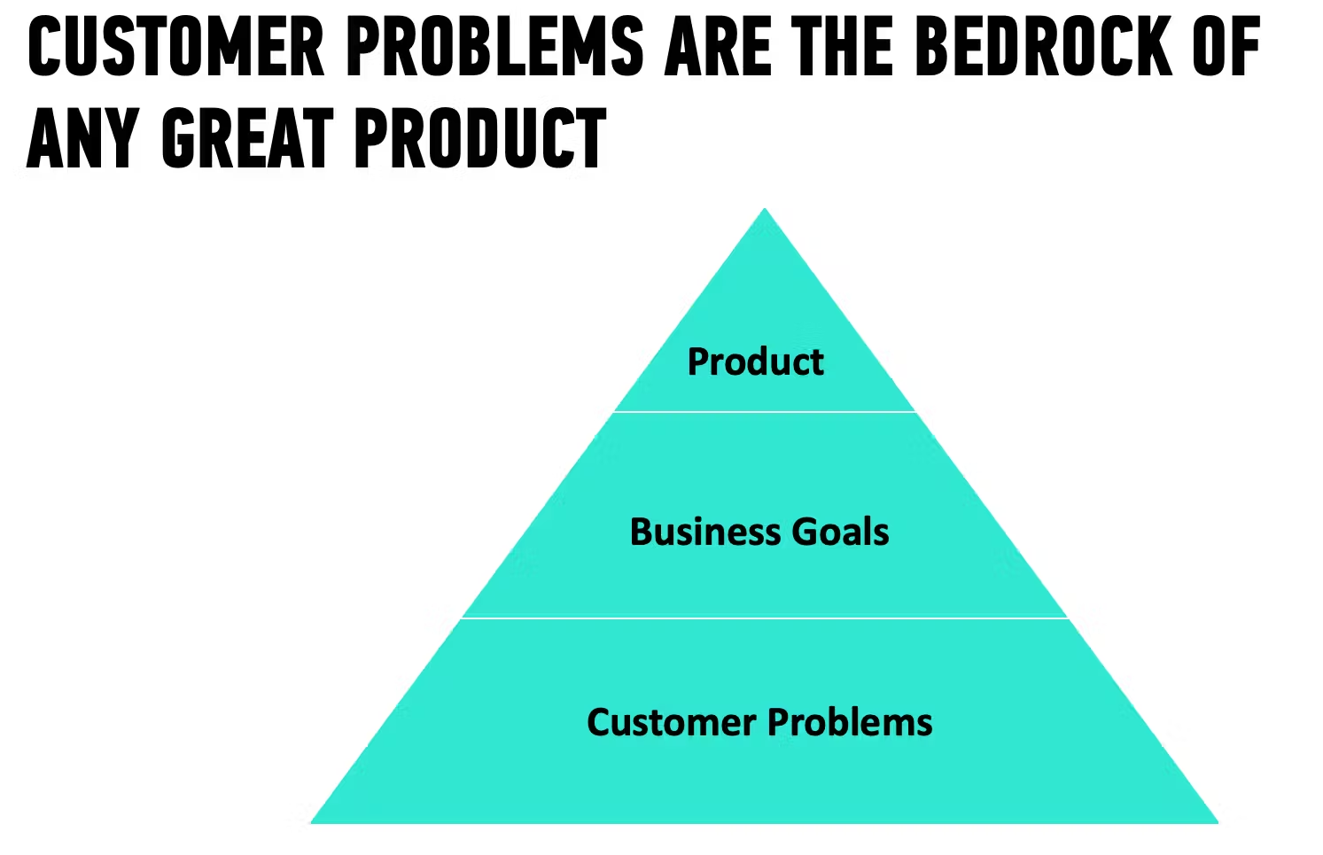
Finding problems to be solved
Notes:
Customer problems don’t change; it’s only technology and customer behaviour that does.

Slide 6
What defines a heart-felt problem?
Customer problems exist across multiple layers. There’s a surface layer where they tell you a solution they have in mind—like I want to save money making international calls. But at its core, all problems distill down to one or a few of these emotions:
Security
Attention
Control
Meaning & purpose
Privacy
Community
Intimacy
Status
Achievement

Slide 7
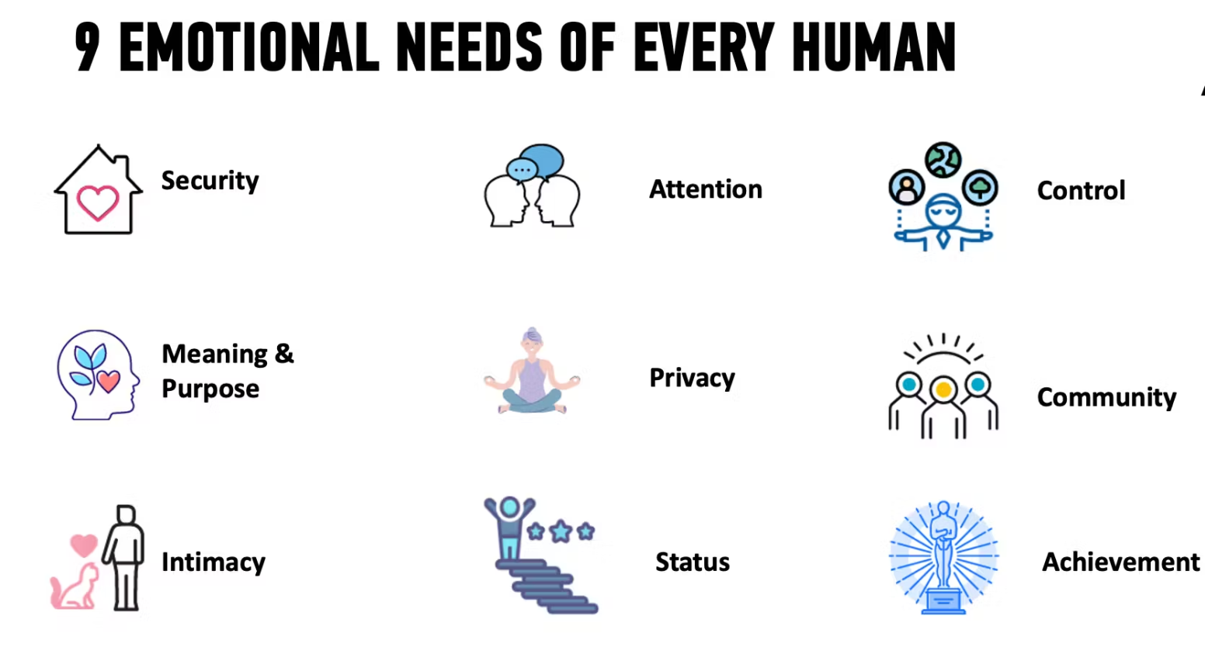
What defines a heart-felt problem?

Slide 8
What defines a heart-felt problem?
Great entrepreneurs look beyond the customer-suggested problems. They ask “5 why’s” until they get to the emotional reason that causes a customer to seek out a product.
Take the case of Slack, a workplace communication tool that has revolutionized how offices communicate.
Before Slack existed, office communication relied on email. Email was designed to be formal and disposable. However, Slack channels allowed teams with a shared interest to create more inclusive communication for everyone.
Suddenly, people working on the same project can create a project channel with a “searchable log of all communication and knowledge” (which is what SLACK stands for). What used to be an email thread now has a permanent space to foster a discussion around a common goal.

Slide 9
Five characteristics of heart-felt problems
Here are the five characteristics of heart-felt problems. The deeper the pain, the more value you can get from your customers:
Emotional — the problem must have an emotion attached to it
Functional — the problem must fulfill the basic functional need of the problem
Frequent — the problem must happen frequent enough for the user to justify the value
Urgent — the problem must have an impending deadline
Unavoidable — the problem must not have an easier way to get around the problem

Slide 10
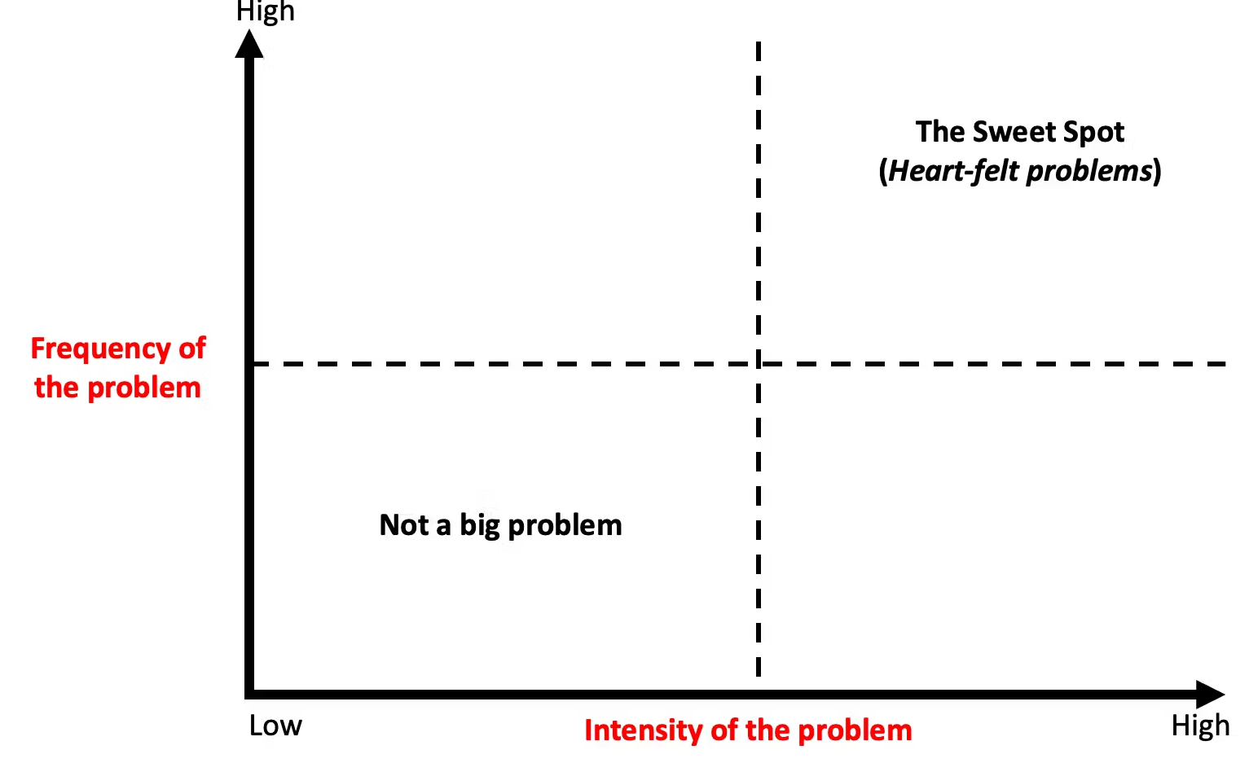
Heart-felt problems

Slide 11
Identify if a heart-felt problem is worth solving?
You’ll need to generate product ideas from market research and then identify customers' problems in that market to solve.
The first step is to research the market you want to be a part of. The opportunity size is based on how much your customer is spending to solve the problem right now. This information can come from industry research, government websites, and annual reports of key competitors, or you may even need to commission research if it’s too niche.

Slide 12
Identify if a heart-felt problem is worth solving?
You need to get out of your comfort zone and speak with your target customers. Put yourself in their shoes, and think about the problem you’re trying to solve.
Ask yourself: If this customer problem exists, where would your customers go to solve it?
Chances are there are existing communities or media channels that connect your potential customers. Go there.
And don’t be afraid to speak with your competitor’s customers to understand why they purchased the product and what problem it was solving for them.
There is no magic number of how many customer interviews you speak with. Start with five customers first, then adjust the questions every five customers until you have honed in on a deep enough problem with a large enough market size.

Slide 13
Identify if a heart-felt problem is worth solving?
The trick is to find a deep customer problem in a market that is large enough to sustain your vision. 99% of the worlds problems are not worth solving but if you persist, you’ll eventually find one.
Using the Jobs-To-Be-Done interview popularized by Clayton Christensen is an excellent method to speak with customers. Using the Jobs To Be Done framework is a blog post on its own.
Once you’ve found a heart-felt problem in a large enough market—the next step is to reframe the problem to look at it from varied perspectives. Doing so will help you make better decisions and arrive at radically better solutions.

Slide 14
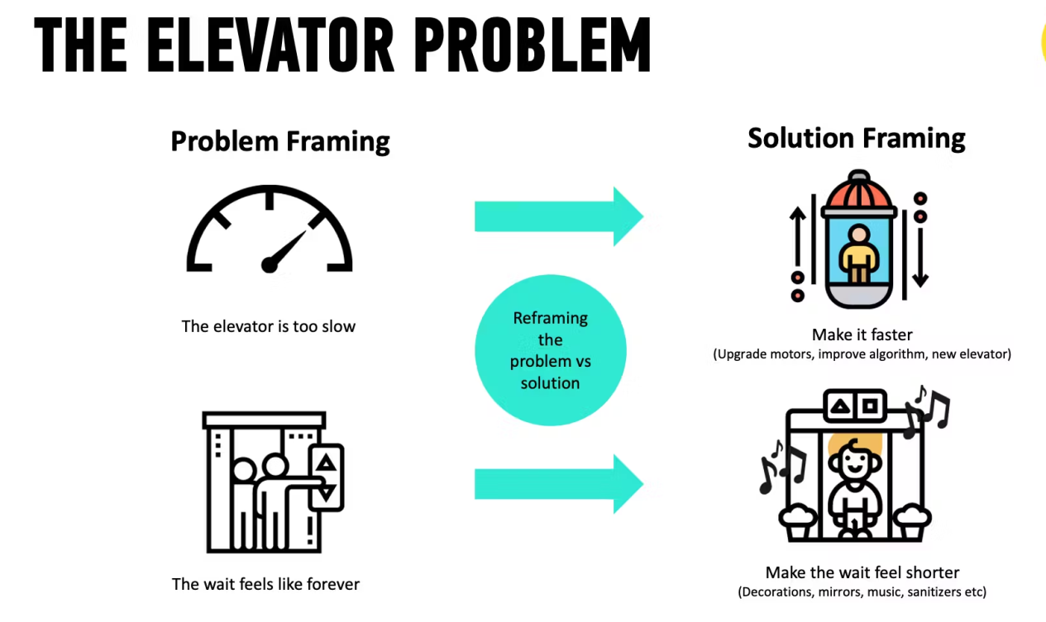
Example
Let's take the classic example of a slow elevator in a building. A heart-felt problem for tenants is “I feel like I’m wasting time” (an emotional problem that’s related to status, purpose and meaning).

Slide 15
Example
The solution seems obvious - find a way to upgrade the elevator motor to make it go faster or change the algorithm to prioritise floors.
While these are straightforward solutions, there are significant costs (time & money) associated with installing a new motor or a new algorithm. However, if we remove the problem from the solution, we can find more ways to solve the problem. Perhaps providing hand sanitisers, playing music or even the daily news might be a cheaper option to make the wait time “more meaningful”.

Slide 16
Gebbia cofounded Airbnb in 2007, the digital accommodations marketplace that people use to rent out their homes or spare rooms (or igloos, castles, or private islands) like a hotel.
Early on, Airbnb was not getting much traction in New York. So the team flew out and booked rooms with two-dozen hosts to learn why. Users, they found, had no idea how to present their listings. “The photos were really bad,” says Gebbia, who typically sports Twizzler-red sneakers and thick-framed glasses that resemble lab goggles. “People were using camera phones and taking Craigslist-quality pictures. Surprise! No one was booking because you couldn’t see what you were paying for.”

Slide 17
They crafted a very untechy solution. “A web startup would say, ‘Let’s send emails, teach [users] professional photography, and test them,'” explains the jockish Chesky, a former bodybuilder who wanted to play pro hockey. “We said, ‘Screw that.'” The pair rented a $5,000 camera and snapped high-resolution photos of as many New York host apartments as they could. Bookings soared. By month’s end, revenue had doubled in the city. “Rinse and repeat,” Gebbia says. “When we fixed the product in New York, it solved our problems in Paris, London, Vancouver, and Miami.”

Slide 18
Airbnb now offers its hosts free professional photography services from more than 2,000 freelancers who have visited 13,000 listings across six continents. The startup realized the long-term benefits–such as improved aesthetics and verified property addresses–far outweighed the costs. Travelers are two and a half times more likely to book these enhanced listings, which earn their hosts an average of $1,025 per month.

